Slide 1
Enhancing Air Compressor Efficiency in Industry Through ML
Project Guide
Dr. Emmanuel Babu P.
Assistant Professor
Dept. of EEE
MACE
Group Members
Gayathri Vinod Nambiar (MAC20EE042)
Hanna Jahan S (MAC20EE045)
Mohammed Nabeel K (MAC20EE066)
Muhammed Ashiqu (MAC20EE069)

Slide 2
Contents
Enhancing Air Compressor Efficiency in Industry Through ML
Objective
Literature Review
Block diagram
Methodology
Part load efficiency theorem
Constraints Added for Optimization
Optimization
Training data of ML
Feed-forward method
Flowchart
FFN ML Model Output
Hardware
Results
Conclusion
References

Slide 3
Objectives
Enhancing Air Compressor Efficiency in Industry Through ML
To increase the efficiency of air compressors in industries
To collect the input energy parameters
Obtain the desired output data
Choose and train the ML model by using this data
To simulate and implement a perfect model
To save resources and increase cost efficiency

Slide 4
Literature Review
Enhancing Air Compressor Efficiency in Industry Through ML
M. A. Zagorowska, T. Haugen, C. Skourup and N. F. Thornhill, "Load-Sharing With Degradation Management in a Compressor Station," in IEEE Transactions on Automation Science and Engineering, doi: 10.1109/TASE.2023.3237005.
Innovative approach to compressor management
Focusing on degradation levels to optimize operation and maintenance planning
Simplifies load-sharing without needing adjustments to lower-level control structures
F. Babaa, O. Bennis, F. Kratz and A. Hadri-Hamida, "Combined Electrical Faults Detection and Diagnosis Using Current Signature Analysis," 2021 IEEE 13th International Symposium on Diagnostics for Electrical Machines, Power Electronics and Drives (SDEMPED), Dallas, TX, USA, 2021, pp. 52-57, doi: 10.1109/SDEMPED51010.2021.9605509.
The importance of monitoring and diagnosing asynchronous machines in the production chain
Dealing with combined faults like turn-to-turn short circuit faults and unbalanced supply voltage.

Slide 5
Literature Review
Enhancing Air Compressor Efficiency in Industry Through ML
S. Chen, Q. Li and L. He, "The software package by using excel to solve linear programming," Proceedings of the 29th Chinese Control Conference, Beijing, China, 2010, pp. 5115-5119.
Addresses the complexity of the solution process and the limitations of professional software
Software package that harnesses Excel's basic functions
Making it accessible and adaptable for numerous typical linear programming scenarios
P. Phumiphak and C. Chat-uthai, "Induction motor speed measurement using motor current signature analysis technique," 2009 International Conference on Electrical Machines and Systems, Tokyo, Japan, 2009, pp. 1-5, doi: 10.1109/ICEMS.2009.5382862.
Explains the technique based on MCSA
Demonstrates across different motor types without the need for complex machine parameters

Slide 6
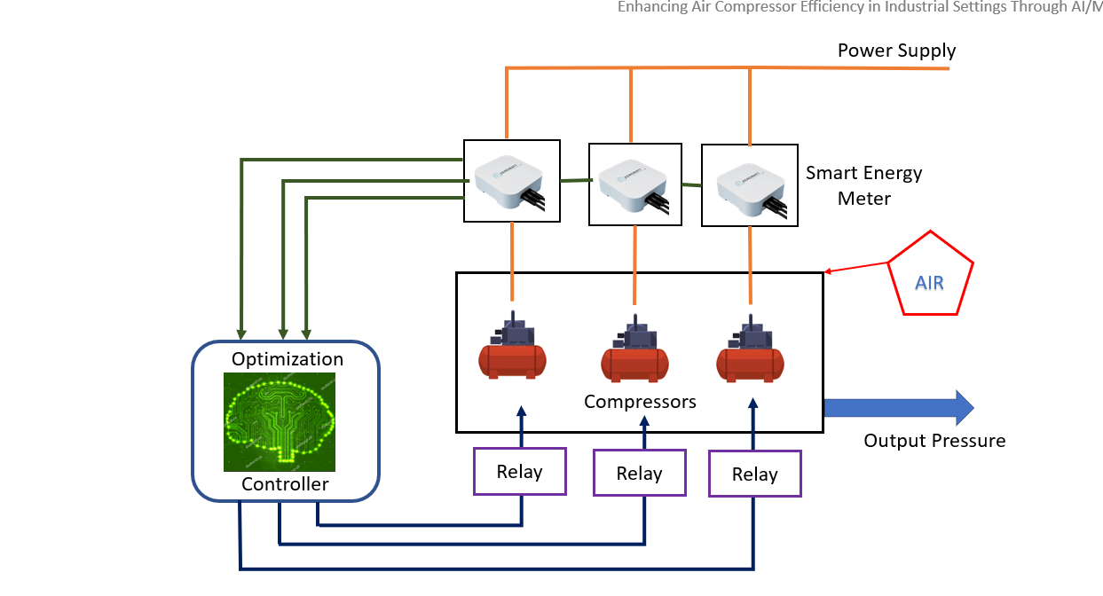
Block Diagram
Enhancing Air Compressor Efficiency in Industry Through ML
Fig 1: Block Diagram

Slide 7
Methodology
Enhancing Air Compressor Efficiency in Industry Through ML
Data Collection and Optimization
Data Analysis in MS Excel
Binary Operation using MS Excel
Model Selection and Training
Model Evaluation
Create regular reports

Slide 8
Part load efficiency reduction
Enhancing Air Compressor Efficiency in Industry Through ML
Compressors should work in a specific range of its full load capacity
4 compressors of 60 kWh rating and 1 of 100kWh rating are used
Compressors should operate above 85% of its full load for maximum efficiency
60kWh compressor should operate in the range between 51-60 kWh
100kWh compressor should operate in the range between 85-100 kWh

Slide 9
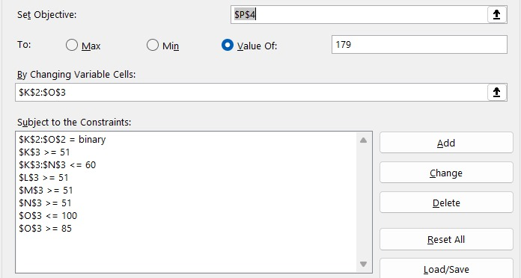
Constraints Added for Optimization
Enhancing Air Compressor Efficiency in Industry Through ML
Load in kWh
ON/OFF
Rating=60kWh
Min value of load
Rating = 100kWh
Min value of load
Fig 2: Constraints added in Excel

Slide 10
Constraints Added for Optimization
Enhancing Air Compressor Efficiency in Industry Through ML
Using solver in excel constraints are added to get the desired data
New set of desired data for the same load
With the help of solver in excel training data for ML is obtained

Slide 11
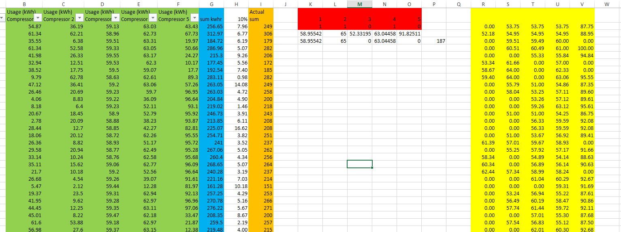
Optimization
Enhancing Air Compressor Efficiency in Industry Through ML
Input Data
Solver
Desired Data
Loss
Fig 3: Optimized Data

Slide 12
Optimization
Enhancing Air Compressor Efficiency in Industry Through ML
Green: Input energy supplied to the compressors
Blue: Total input energy excluding efficiency losses
Orange: Actual total energy consumption after accounting for losses
Red: Indicates which compressors are currently operating ON or OFF
Yellow: Optimized output energy

Slide 13
Optimization
Enhancing Air Compressor Efficiency in Industry Through ML
Collected 1 lakh data from the “Exedy Clutch industries LTD”
By using solver in excel optimized data is obtained
Constraints given for different combination to run the compressor in most efficient way
Collected data and optimized data used as input data to train the ML model

Slide 14
Optimization
Enhancing Air Compressor Efficiency in Industry Through ML
Compressors 2 and 4 are operated with less than 85% of its load
Compressor 2 is operated at 36kWh load
Compressor 4 is operated at 43kWh load
According to part load efficiency reduction the total loss is
36x0.1 + 43x0.1 = 7.9kWh
This energy loss can be prevented by using trained ML model

Slide 15
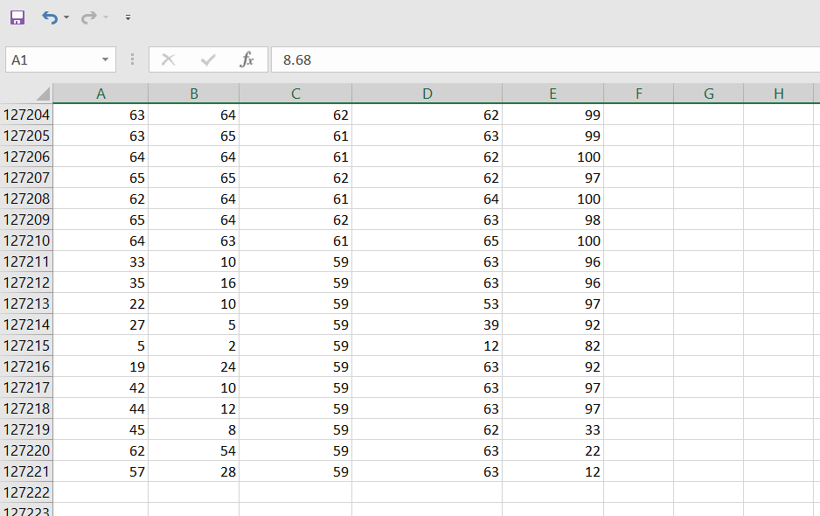
Training data for ML
Enhancing Air Compressor Efficiency in Industry Through ML
C1 (kWh)
C2 (kWh)
C3 (kWh)
C4 (kWh)
C5 (kWh)
Fig 4: Input Data

Slide 16
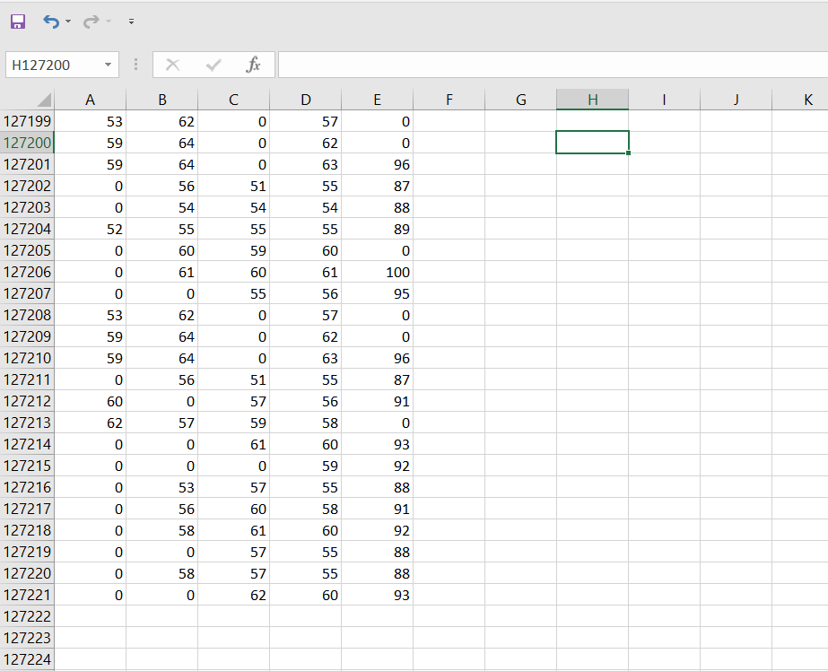
Training data for ML
Enhancing Air Compressor Efficiency in Industry Through ML
C1 (kWh)
C2 (kWh)
C3 (kWh)
C4 (kWh)
C5 (kWh)
Fig 5: Desired output

Slide 17
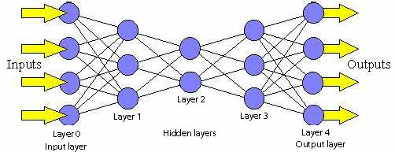
Feed-forward Method
Enhancing Air Compressor Efficiency in Industry Through ML
Inspired by the structure and function of the human brain
ML used to reduce loss and acquire maximum efficiency
Neural networks can be trained
on data
Unidirectional flow of data
Input layer through hidden
layers and to the output layer
Fig 6 : Neural network

Slide 18
Feed-forward Method
Enhancing Air Compressor Efficiency in Industry Through ML
First layer takes in the input data
Subsequent layers process the data
Data processed based on weights and biases
The weights and biases are adjusted to minimize the error
Back propagation algorithm for efficient learning
Output is compared to desired output
This generates an error signal

Slide 19
Feed-forward Method
Enhancing Air Compressor Efficiency in Industry Through ML
Predicting output value based on input data
Learning the relationship between input and output data points
Pattern Recognition
Extracting relevant features from raw input data
Improve the performance machine learning tasks
They are simpler to understand and implement

Slide 20
ML Modelling and Training
Enhancing Air Compressor Efficiency in Industry Through ML
Load the Data
Preprocess the Data
Split the Data
Choose a Model
Train the Model
Evaluate the Model
Notes:
Load the Data: Read the CSV file into your program or environment. Libraries like Pandas in Python are commonly used for this purpose.
Preprocess the Data: Clean the data, handle missing values, encode categorical variables if needed, and scale/normalize numerical features.
Split the Data: Divide the dataset into training and testing sets to evaluate the model's performance.
Choose a Model: Select an appropriate machine learning model based on your problem (e.g., classification, regression) and data characteristics.
Train the Model: Fit the chosen model to the training data.
Evaluate the Model: Assess the model's performance on the testing data to understand how well it generalizes to unseen data.
Tune the Model (Optional): Fine-tune hyperparameters or try different algorithms to improve performance if necessary.

Slide 21
Flowchart
Enhancing Air Compressor Efficiency in Industry Through ML
Start
Read input data from Excel files
Evaluate the model on test data
Read output data from Excel files
Train the model
Normalize input and output
Plot training history
Split data into training and testing sets
Build deep neural network model
End
Fig 7 : Flowchart

Slide 22
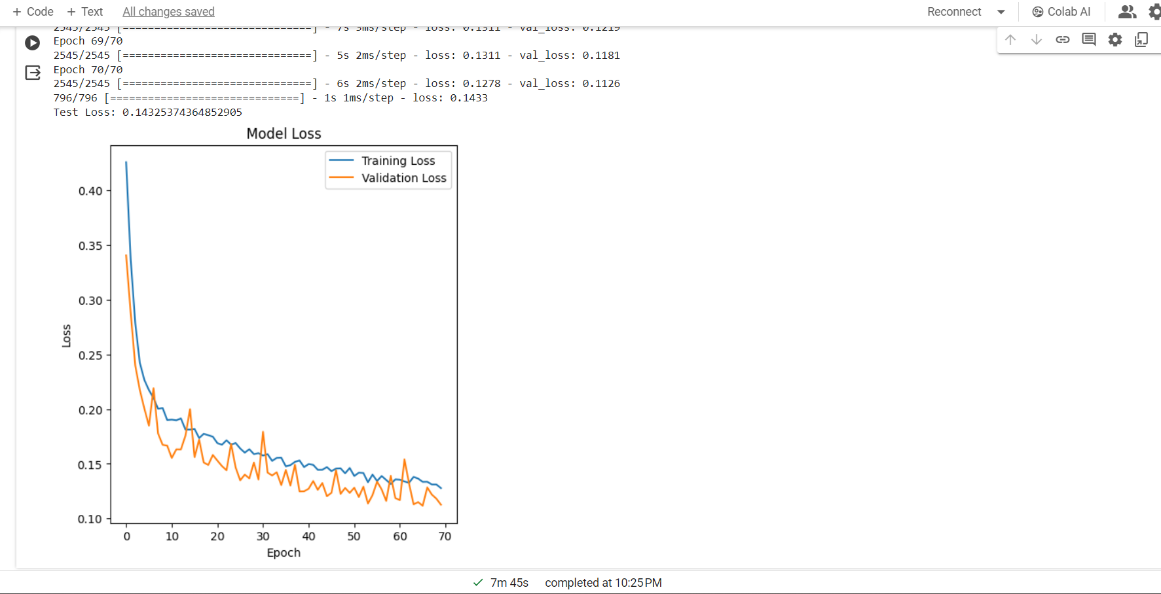
FFN ML Model Output
Enhancing Air Compressor Efficiency in Industry Through ML
Test loss = 0.143
Fig 8 : FFN model output

Slide 23
FFN ML Model Output
Enhancing Air Compressor Efficiency in Industry Through ML
Trained the ML model with 1 lakh input and desired data
Training Loss and validation loss reduced
The model is uploaded to raspberry pi

Slide 24
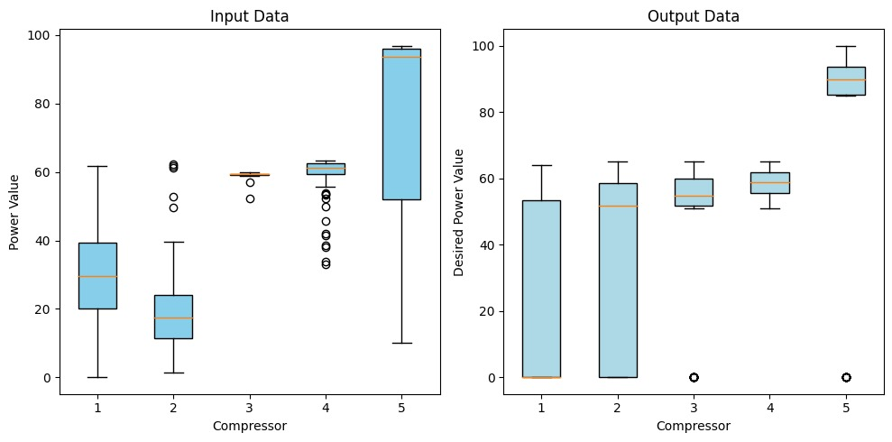
FFN ML Model Output
Enhancing Air Compressor Efficiency in Industry Through ML
Fig 9 : Data visualization

Slide 25
FFN ML Model Output
Enhancing Air Compressor Efficiency in Industry Through ML
Input data visualization depict that mostly compressors run below 85% of its full load
Red line depicts majority of data in that range
In desired data visualization depicts that compressors run either above 85% of its full load or OFF

Slide 26
Components Used
Enhancing Air Compressor Efficiency in Industry Through ML
Raspberry Pi 4b 8GB
SanDisk Micro SD/SDHC 32GB Class 10 memory card
5V 4-channel relay module
5V 1-channel relay module
Micro HDMI Male to HDMI female Adapter
Female to male jump wires

Slide 27
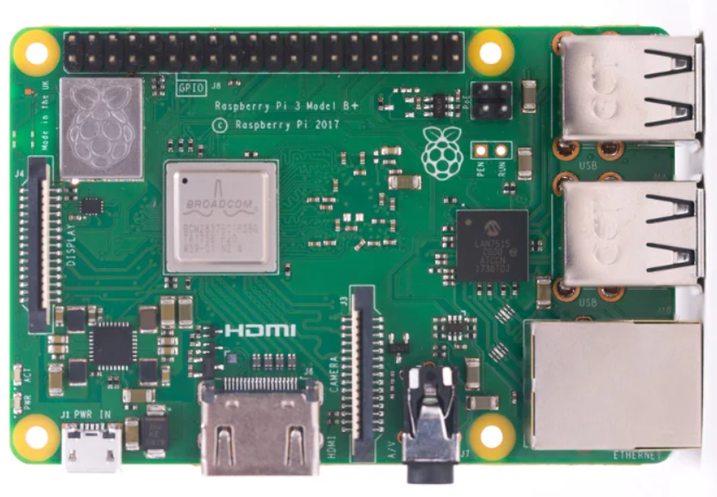
Enhancing Air Compressor Efficiency in Industry Through ML
Components Used
Raspberry Pi 4b 8GB
5 pins used to ON/OFF the relay
Pin 17, 18, 22, 23, 24 are used
Used mobile charger as power supply
32 GB SD card is inserted
Trained ML model is uploaded
Fig 10 : Raspberry Pi

Slide 28

Components Used
Enhancing Air Compressor Efficiency in Industry Through ML
SD Card
Primary storage medium
Reads the bootloader from the SD card
Loads the operating system into the Pi's memory
Used to create backups of the Raspberry Pi
Regular backups help prevent data loss
Fig 11 : SD card

Slide 29
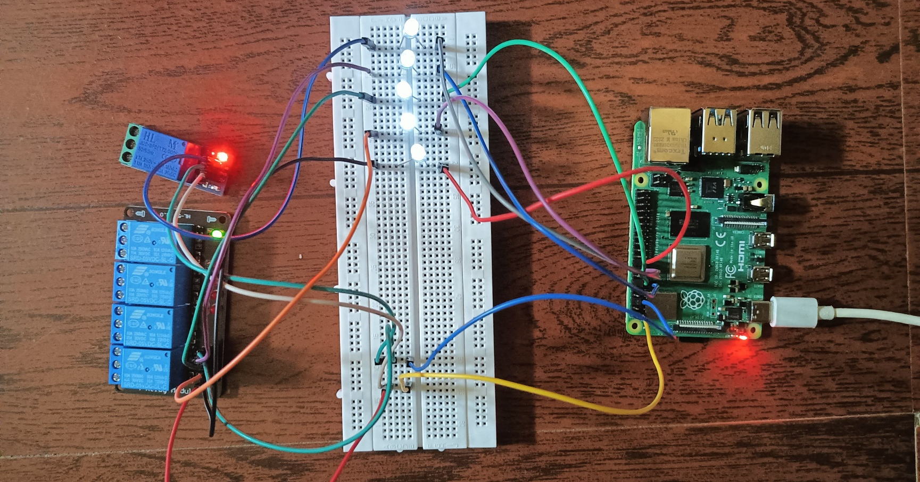
Hardware
Enhancing Air Compressor Efficiency in Industry Through ML
Fig 12 : Hardware setup

Slide 30
Hardware
Enhancing Air Compressor Efficiency in Industry Through ML
ML model is trained with 1 lakh data
The model accuracy has been increased
The trained ML model is uploaded to the Raspberry pi
Set of four relays control four 60 kWh compressors
They are connected to GPIO pins 17,18,22,23
One relay control a 100 kWh compressor
It is connected to GPIO pin 24
LEDs indicate whether the relays are ON or OFF

Slide 31

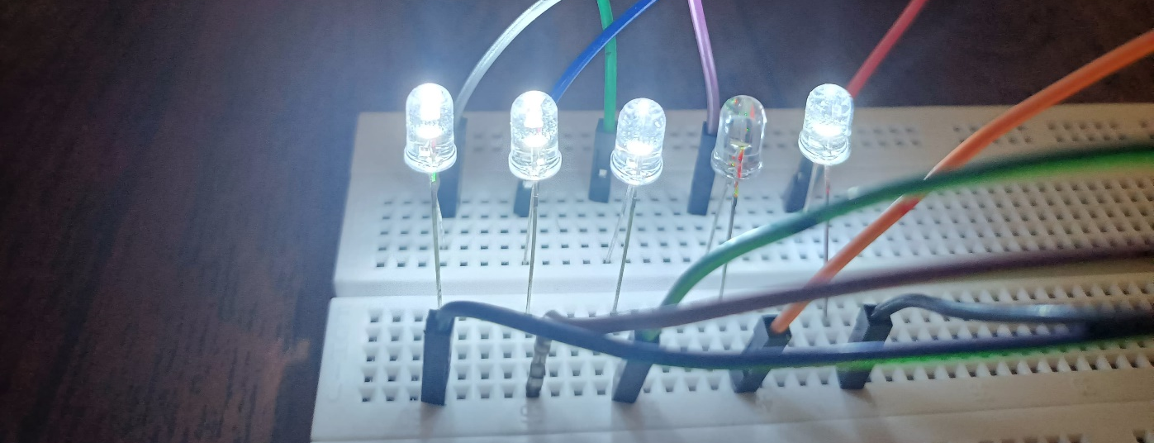

Results
Enhancing Air Compressor Efficiency in Industry Through ML
1.Test data
3.Result
2. ML output
Fig 13: Output combination 1

Slide 32

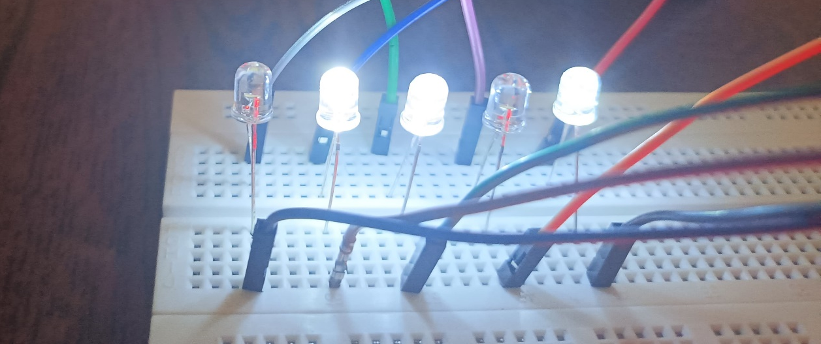

Enhancing Air Compressor Efficiency in Industry Through ML
Results
1.Test data
3.Result
2.ML output
Fig 14: Output combination 2

Slide 33
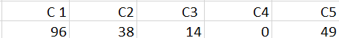
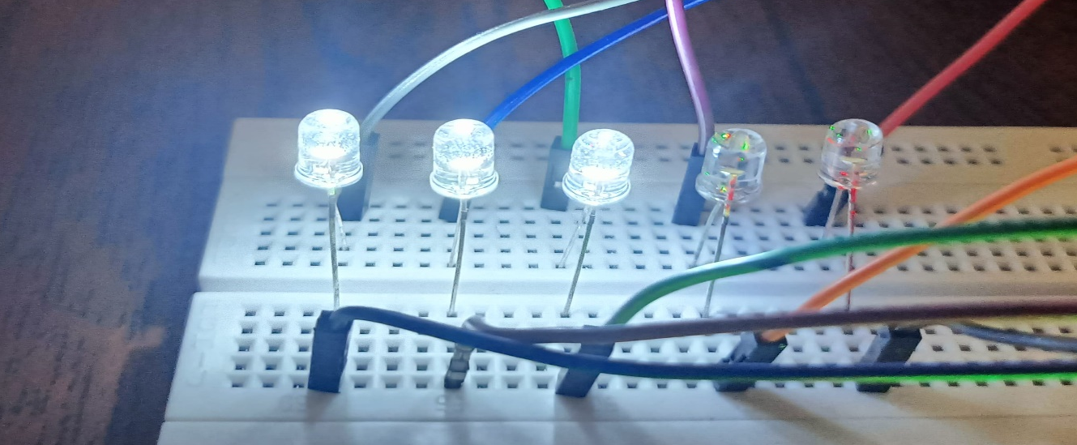

Results
Enhancing Air Compressor Efficiency in Industry Through ML
1.Test data
3.Result
2.ML output
Fig 15: Output combination 3

Slide 34
Enhancing Air Compressor Efficiency in Industry Through ML
Results
LEDs indicate whether compressors are ON/OFF
Data is fed to raspberry pi
Trained ML model make decision regarding which compressors has to be operated to reduce the energy loss
Here LEDs indicate whether the compressors are turned ON/OFF
LEDs will depict which the pattern that trained ML model decide to run the compressors in most efficient way

Slide 35
Conclusion
Enhancing Air Compressor Efficiency in Industry Through ML
Prepared constraints in excel to obtain optimized data
Implemented a suitable python code for FFN model
Trained the data set in FFN model
Prepared ML model to increase efficiency of compressors
Uploaded the model in raspberry pi
Tested the model
Model helps in increasing cost efficiency and save resources

Slide 36
Journal Submission
Enhancing Air Compressor Efficiency in Industry Through ML
Journal submitted to ‘International Journal of Information Technology and Electrical Engineering’ which is named as ‘Enhancing Air Compressor Efficiency in Industry Through ML’

Slide 37
References
Enhancing Air Compressor Efficiency in Industry Through ML
[1] | F. Babaa, O. Bennis, F. Kratz and A. Hadri-Hamida, "Combined Electrical Faults Detection and Diagnosis Using Current Signature Analysis," 2021 IEEE 13th In- ternational Symposium on Diagnostics for Electrical Machines, Power Electron- ics and Drives (SDEMPED), Dallas, TX, USA, 2021, pp. 52-57, doi: 10.1109/S- DEMPED51010.2021.9605509
[2] | N. Bhole and S. Ghodke, "Motor Current Signature Analysis for Fault Detection of Induction Machine-A Review," 2021 4th Biennial International Conference on Nascent Technologies in Engineering (ICNTE), NaviMumbai, India, 2021, pp. 1-6, doi: 10.1109/ICNTE51185.2021.9487715.
[3] | S. Chen, Q. Li and L. He, "The software package by using excel to solve linear pro- gramming." Proceedings of the 29th Chinese Control Conference, Beijing, China, 2010, pp. 5115-5119.
[4] | V. J. Raj, "Solution to Linear Programming Patterns using Machine Learn-ing," 2022 International Virtual Conference on Power Engineering Computing and Control: Developments in Electric Vehicles and Energy Sector for Sus- tainable Future (PECCON), Chennai, India, 2022, pp. 1-3, doi: 10.1109/PEC- CON55017.2022.9851115.
[5] | A. Jaradat, H. Lutfiyya and A. Haque, "Smart Home Energy Visualizer: A Fusion of Data Analytics and Information Visualization," in IEEE Canadian Journal of Electrical and Computer Engineering, vol. 45, no. 1, pp. 77-87, winter 2022, doi: 10.1109/ICJECE.2021.3134499.

Slide 38
THANK YOU
Enhancing Air Compressor Efficiency in Industry Through ML

